Slide 1



High Cloud Airlines Analytics
Presented By: Group No.- 03
Rekha Naresh Balsara
Karumanchi Haseena
Moyyi Kusumakumari
Muhammed Rashid K
Praveenkumar Badanikai
Tarish Grover

Slide 2

CONTENTS
Introduction
Objective
Business Overview
Data Model challenges
KPI’s Analysis
Dashboards
Excel Dashboard
Tableau Dashboard
Power BI Dashboard
MySQL Query
Recommendation
Conclusion

Slide 3

INTRODUCTION
High Cloud Airlines is an airline operating a wide network of domestic and international routes.
High Cloud Airlines is committed to delivering reliable service, optimizing load factors, and enhancing the overall travel experience for its passengers.
As part of its growth strategy, the airline continually leverages data-driven insights to improve performance and make informed business decisions.
High Cloud embraces innovation and modern technology to enhance operational efficiency and stay at the forefront of the aviation landscape.
High Cloud Airlines aims to provide exceptional travel experience while prioritizing sustainability and innovation.
Customer satisfaction by offering personalized services, including flexible booking options.
Committed to providing a safe and secure environment for our passengers .
Offer a wide range of domestic and international routes, connecting major cities and popular travel destinations.

Slide 4

OBJECTIVE
To gain a comprehensive understanding of “High Cloud Airlines” operations through data analysis. This will involve investigating load factors, identifying top carrier names based on passenger preference, analyzing popular routes, and exploring other key metrics.
Additionally, the project focuses on boosting operational efficiency by Optimizing flight operation, reducing delays, and improving on-time performance. The ultimate goal is to provide actionable recommendations that can enhance operational efficiency and profitability.

Slide 5

Business Overview
In today’s competitive airline industry, data analysis plays a critical role in optimizing operations and maximizing profitability. By harnessing the power of data, High Cloud Airlines can gain valuable insights into various aspects of its business, allowing them to make data-driven decisions that can lead to
Improved load factor
Enhance Passenger Experience Optimized resource allocation Data- Driven Decision Making

Slide 6

Data Model challenges
Throughout our analysis, we encountered various challenges in handling the data. Overcoming these challenges is crucial for accurate insights.
Data Volume: Managing and Processing large datasets efficiently.
Data Quality: Ensuring accuracy and reliability of the data.
Complex Relationships: Establishing connections between different data points.
Errors and Duplicates: Cleaning data to fix incorrect values and remove duplicates.
Outliers: Flagging and handling unusual data for accuracy.
Route

Slide 7





KPI’s Analysis
Date Fields (Year, Month, Quarter, etc.):
Identify seasonal trends and busiest periods for better planning.
Spot weekday vs. weekend travel patterns to allocate resources effectively.
Load Factor Percentage (Yearly, Quarterly, Monthly):
Monitor seat utilization efficiency.
Highlight underutilized periods for improvement or cost reduction.
Load Factor by Carrier:
Compare carrier performance in seat utilization.
Identify top-performing and underperforming carriers.
Top 10 Carriers by Passengers:
Reveal most popular carriers.
Focus on improving customer experience for less-preferred carriers.
Top Routes (From-To City):
Highlight busiest routes for better scheduling and resource allocation.
Identify routes with growth potential or need for additional flights.
Load Factor: Weekends vs. Weekdays:
Understand leisure vs. business travel trends.
Optimize pricing strategies for weekends and weekdays.
Flight Search Filter (Source to Destination):
Analyze popular routes and demand patterns for better route planning.
Flights by Distance Groups:
Identify demand for short-haul, medium-haul, and long-haul flights.
Optimize aircraft allocation and explore new opportunities.

Slide 8

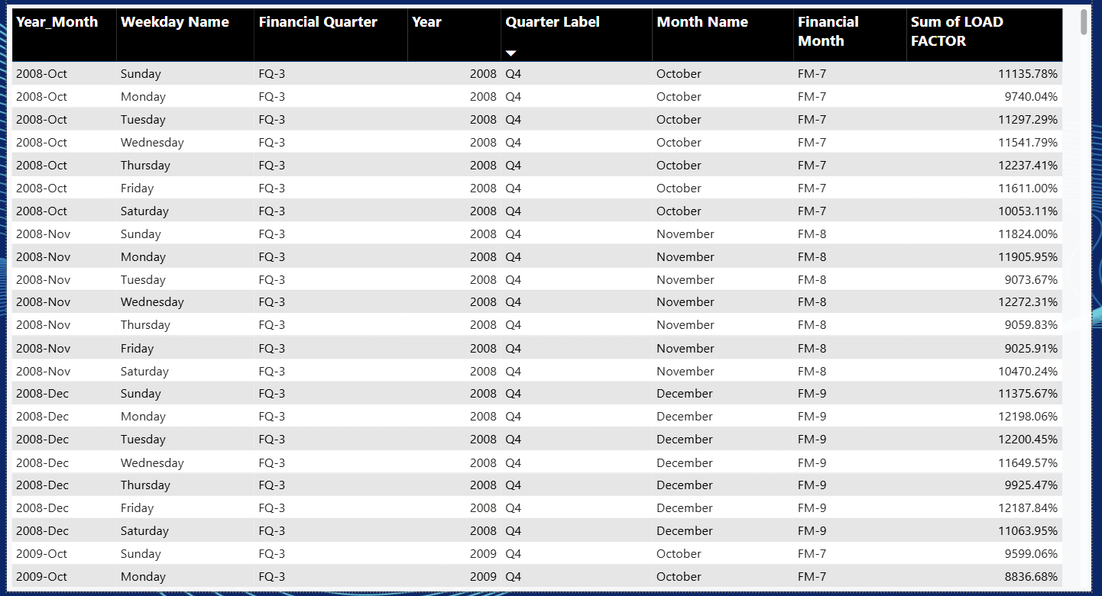
AIRLINE KPI’s FRAMEWORK

Slide 9
KPI-1: YEARLY LOAD FACTOR%
Observation
The yearly load factor shows how efficiently airlines utilized available seats over different years.
Some years recorded higher passenger occupancy, indicating stronger travel demand.
Lower load factor years may indicate reduced operational efficiency or lower passenger demand.
Suggestion
Airlines should increase flight frequency during high-demand years.
Low-performing years should be analyzed for operational inefficiencies or market disruptions.
Dynamic pricing and route optimization can improve seat occupancy.
Conclusion:
Yearly load factor is a strong indicator of airline operational efficiency and passenger demand trends.
Maintaining consistently high load factors improves profitability and resource utilization.

Slide 10
KPI-2: QUARTERLY LOAD FACTOR:
Observation:
Certain quarters show significantly higher load factors due to seasonal travel demand.
Vacation periods and festive seasons generally contribute to increased passenger traffic.
Some quarters experience lower occupancy levels.
Suggestion:
Airlines should introduce seasonal offers during weaker quarters.
Increase marketing campaigns before peak quarters.
Capacity planning should align with seasonal demand fluctuations.
Conclusion:
Quarterly analysis helps airlines identify seasonal travel patterns and optimize operations accordingly.

Slide 11
KPI-3: Monthly load factor
Observation:
Passenger occupancy fluctuates month-wise throughout the year.
Peak travel months contribute heavily to airline revenue.
Off-season months show comparatively lower seat utilization.
Suggestion:
Introduce promotional fares during low-demand months.
Schedule aircraft maintenance during off-peak months.
Improve customer loyalty programs to stabilize demand.
Conclusion:
Monthly load factor analysis enables better operational planning and demand forecasting.

Slide 12
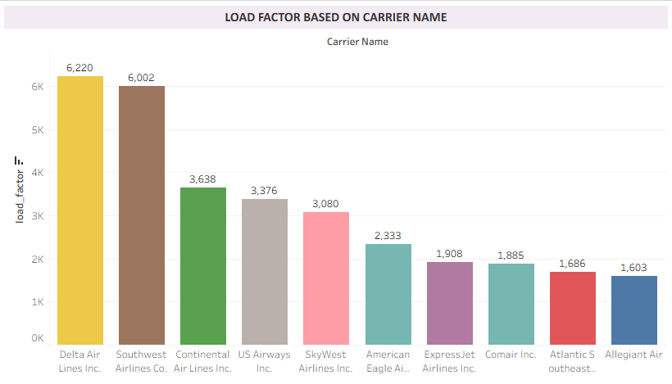
KPI-4: Load Factor By Carrier Name
Observation:
Some airlines maintain consistently higher load factors compared to competitors.
High-performing carriers indicate strong customer preference and efficient route management.
Low-performing carriers may face route or pricing challenges.
Suggestion:
Low-performing airlines should review ticket pricing strategies and service quality.
Benchmarking against top-performing carriers can improve performance.
Focus on customer satisfaction and punctuality.
Conclusion:
Carrier-wise load factor comparison helps identify competitive strengths and operational weaknesses.

Slide 13
KPI-5: Top 10 Carriers based on passenger Preference
Observation:
A small number of carriers dominate total passenger traffic.
Popular airlines likely benefit from stronger brand value, connectivity, and service quality.
Passenger concentration is uneven across airlines.
Suggestion:
Smaller carriers should improve network connectivity and customer experience.
Focus on digital marketing and loyalty programs to attract passengers.
Expand routes in high-demand regions.
Conclusion:
Passenger preference analysis highlights market leaders and helps evaluate airline competitiveness.

Slide 14
KPI-6: Top Routes based on number of flights
Observation:
Certain routes experience extremely high flight frequency.
High-demand routes are likely major business or tourism corridors.
Some routes contribute significantly to total airline operations.
Suggestion:
Airlines should allocate larger aircraft on high-demand routes.
Introduce additional flights during peak travel periods.
Explore underserved profitable routes for expansion opportunities.
Conclusion:
Route analysis helps optimize network planning and improve operational efficiency..

Slide 15
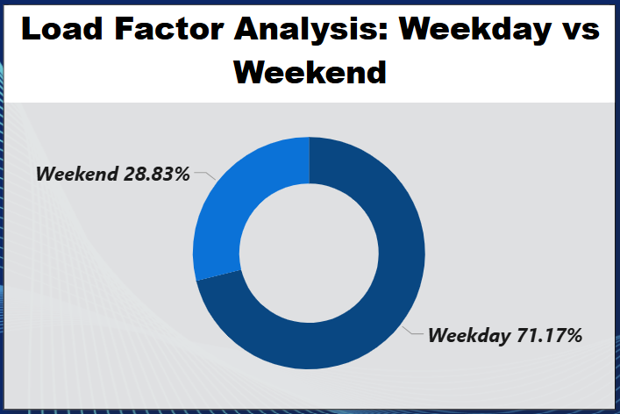
KPI-7: Weekend vs Weekday Load Factor
Observation:
Weekend load factors may differ significantly from weekdays.
Leisure travel tends to increase during weekends.
Business travel contributes more during weekdays.
Suggestion:
Introduce weekend vacation packages and special fares.
Adjust pricing dynamically between weekdays and weekends.
Schedule business-focused flights during weekdays.
Conclusion:
Understanding passenger behavior across weekdays and weekends improves revenue management strategies.

Slide 16
KPI-8: Flights based on distance group
Observation:
Short and medium-distance routes generally account for higher flight volumes.
Long-distance routes may have fewer flights but higher operational costs.
Passenger demand varies across different distance categories.
Suggestion:
Optimize aircraft allocation according to route distance.
Improve fuel efficiency for long-haul routes.
Focus on increasing profitability in underperforming distance groups.
Conclusion:
* Distance group analysis supports better fleet utilization and route planning.

Slide 17
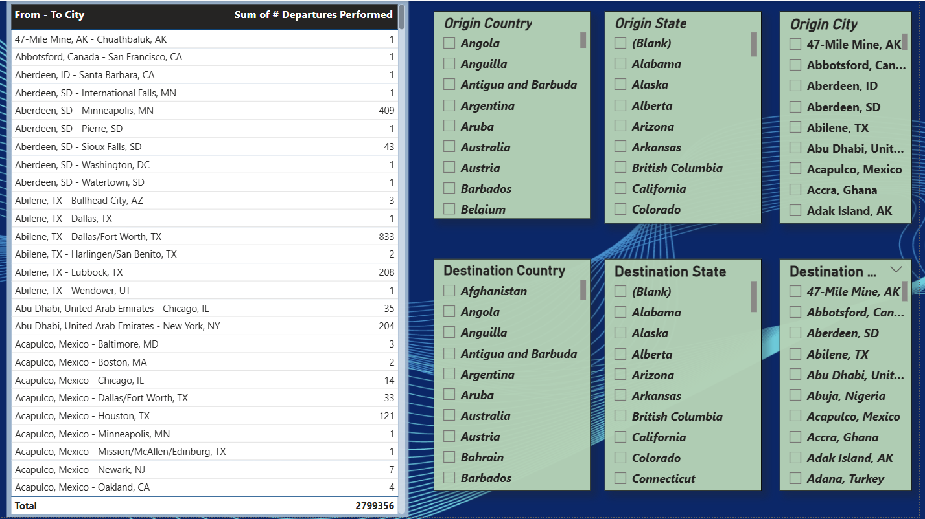
Flight Search Filter (Source to Destination):
(From-To City)

Slide 18

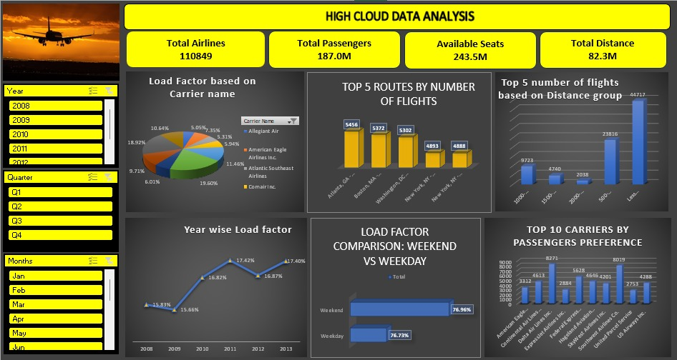
Excel Dashboard

Slide 19
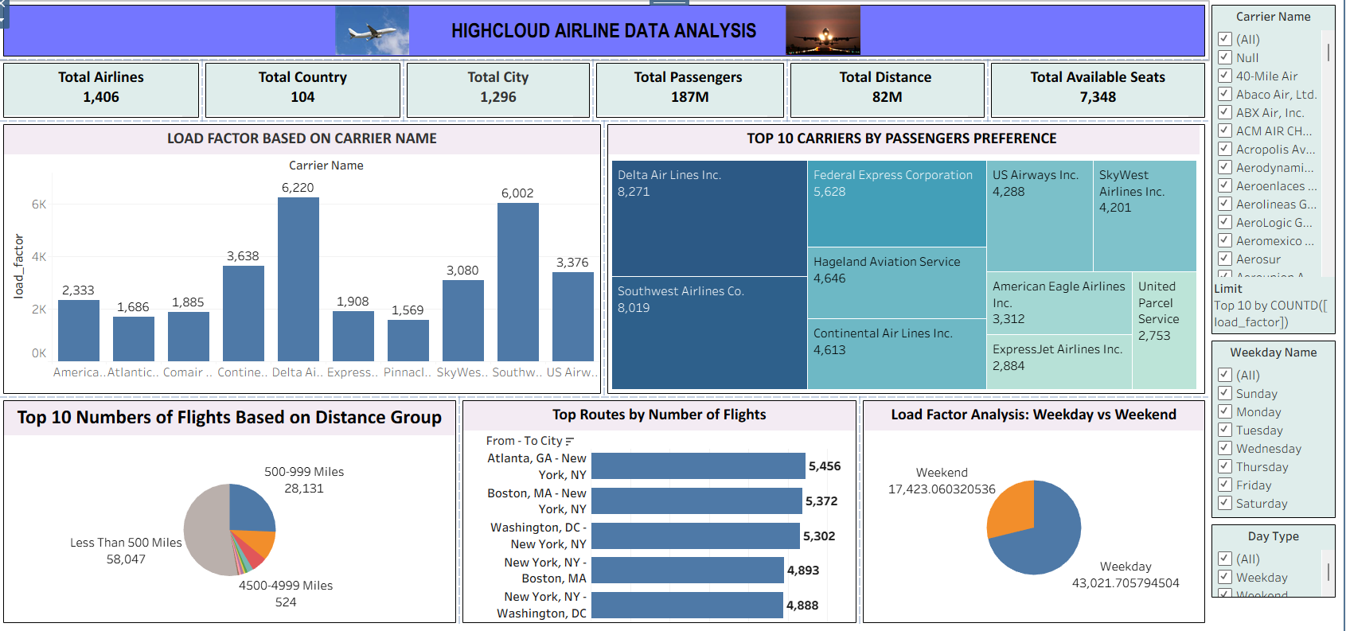
TABLEAU Dashboard

Slide 20
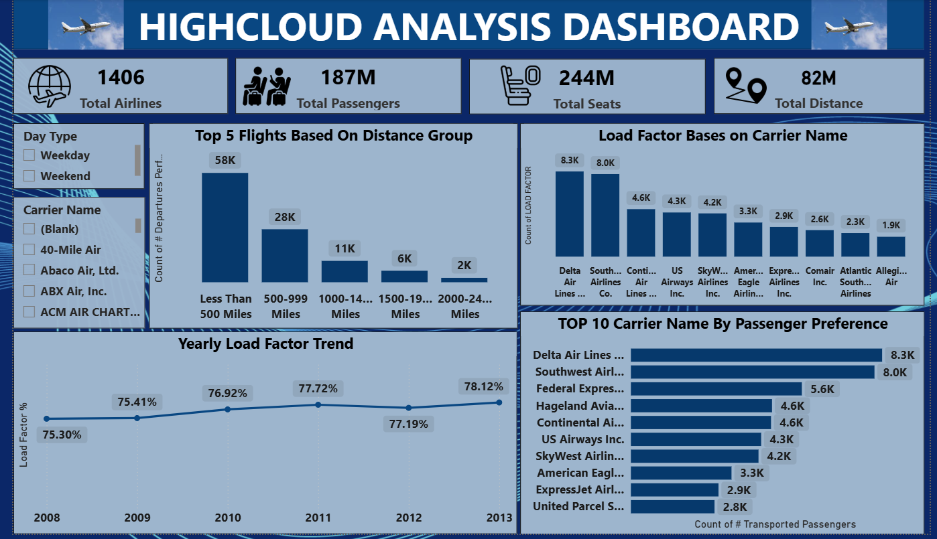
POWERBI Dashboard

Slide 21
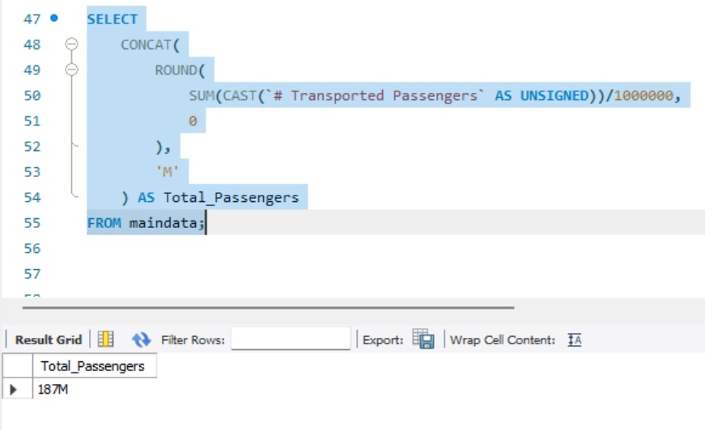
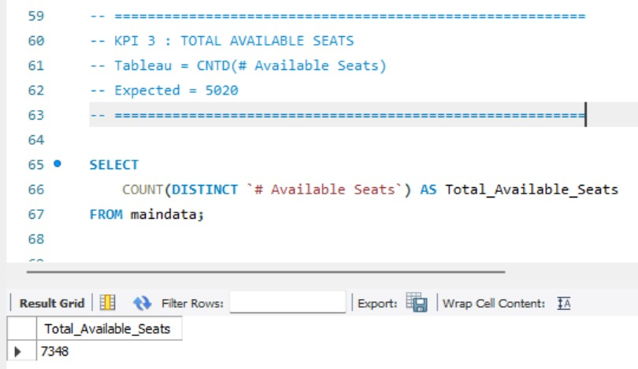
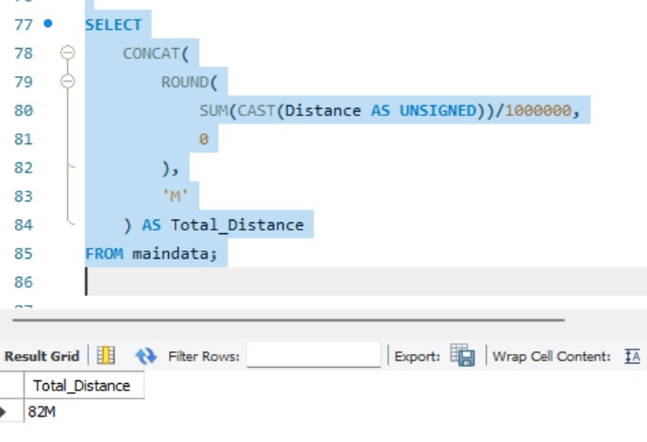
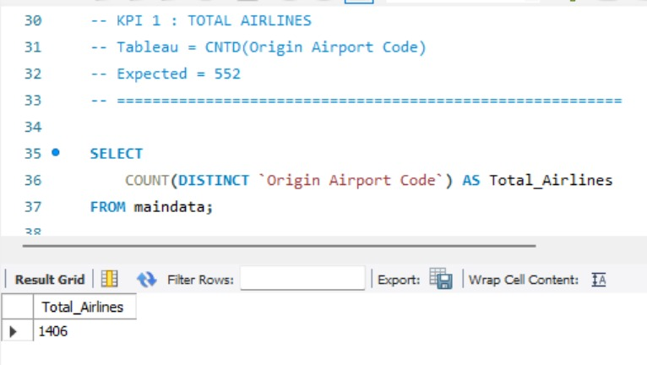
Mysql WOrk

Slide 22
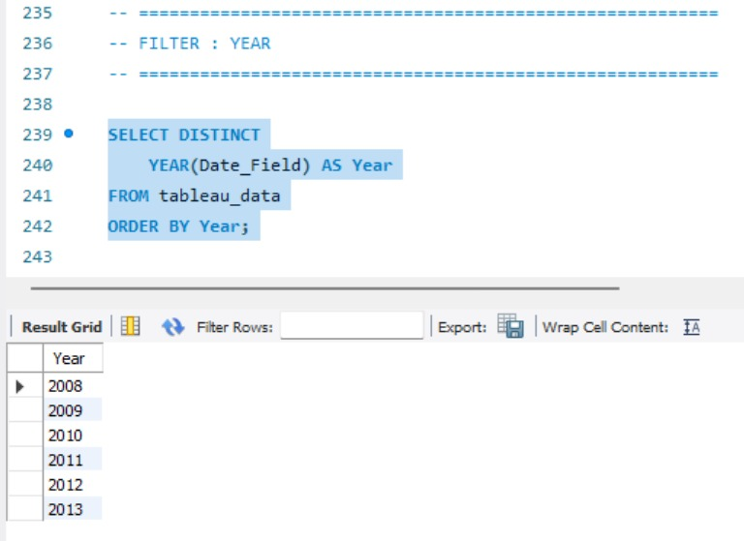
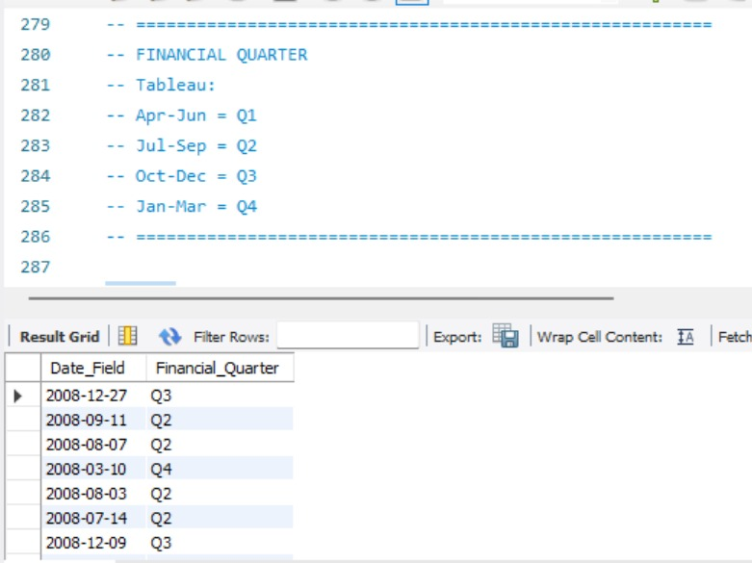
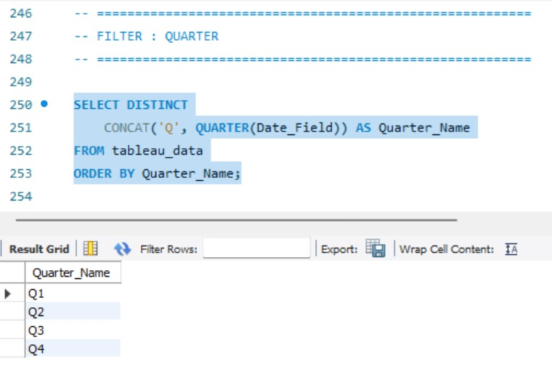
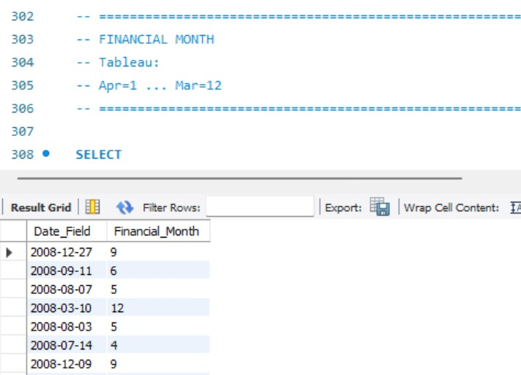
Mysql WOrk

Slide 23
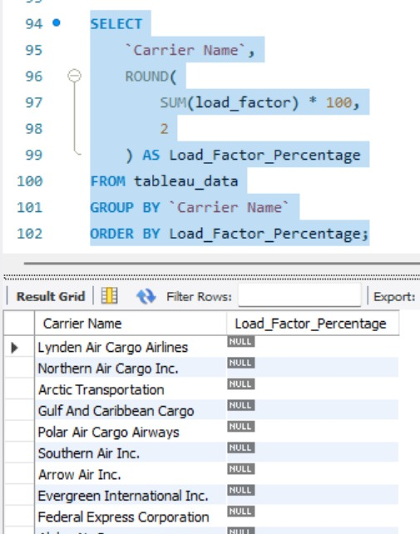
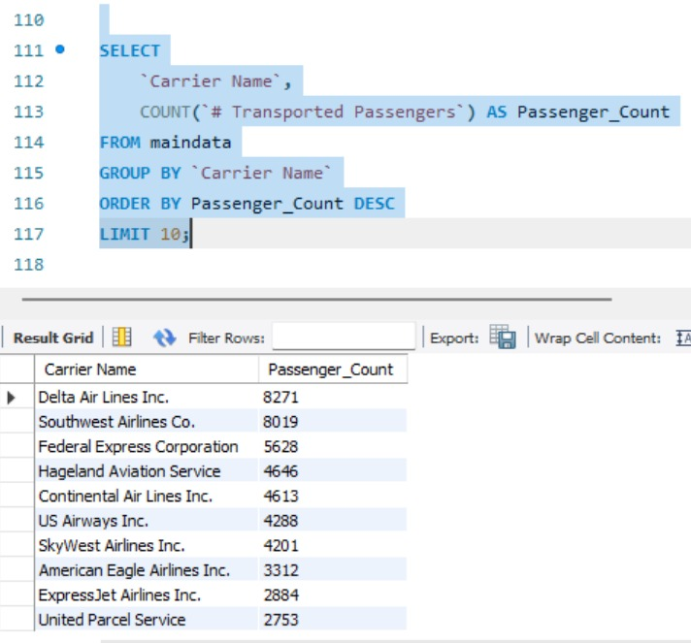
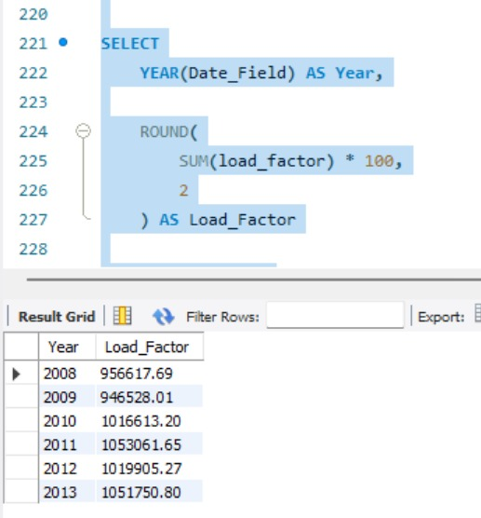
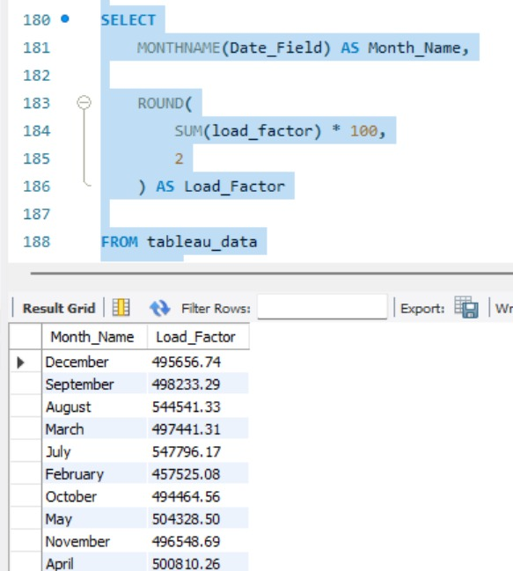
Mysql WOrk

Slide 24
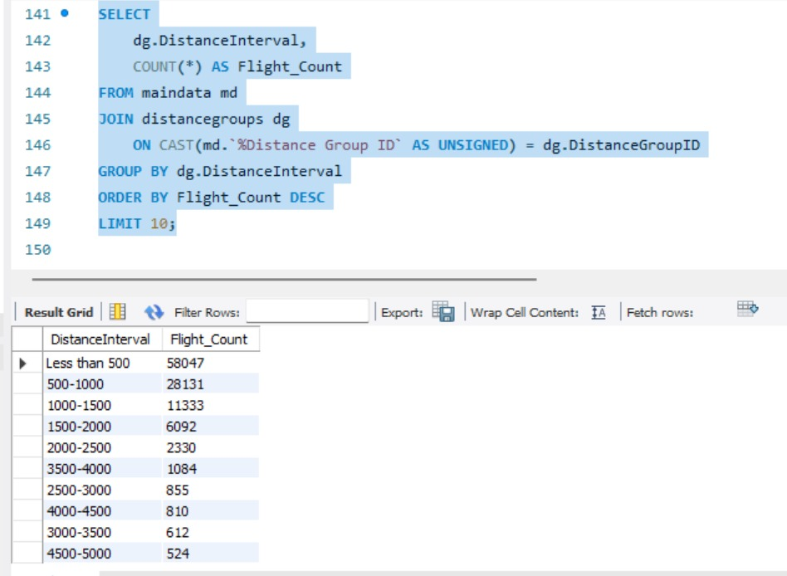
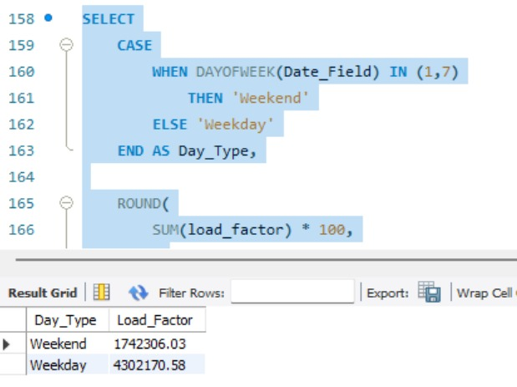
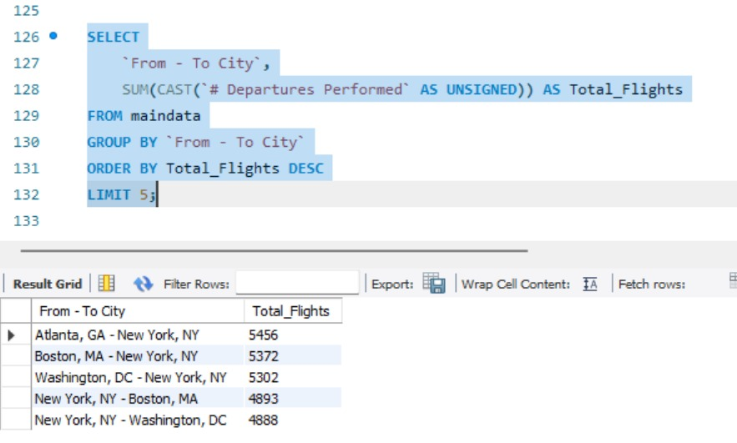
Mysql WOrk

Slide 25
High Cloud Airlines demonstrates a strong operational presence with wide reach and consistent load factors.
However, area like seat utilization, flight cancellations, and dependency on select routes/carriers require attention.
By acting on the identified problems and implementing data-driven solutions, the airline can improve efficiency, profitability, and customer satisfaction.
High Cloud Airlines empowers the aviation industry with actionable insights, foresting efficiency, and strategic decision-making. The presented KPIs offer a glimpse into the vast potential for improvement and growth within the industry. By harnessing the power of data, we can drive positive changes, ensuring a bright future for High Cloud Airlines and its partners in the aviation sector.
High Cloud Airlines aims to expand its route network while maintaining a focus on safety and reliability.
Airline is well-positioned to navigate future industry dynamics and continue delivering value to its customers and stakeholders.
CONCLUTION

Slide 26

High Cloud Airlines Analytics

